Slide 1

Presentation on Beginner Level Game
RAJSHAHI UNIVERSITY OF ENGINEERING & TECHNOLOGY
Course No : CSE 2188(Software Engineering Sessional)

Slide 2
Group – 04 Members:
Abhirup Sarker 1908017
Razia Sultana 1908019
Sakib Anjum Amio 1908020
Sadia Tasneem 1908021
Sarwan Sadique 1908022
Under the supervision of:
Md.Faisal Rahman Badal, Lecturer, Department of Mechatronics Engineering, RUET
Md.Mehedi Hasan, Lecturer, Department of Mechatronics Engineering, RUET

Slide 3


THE HUNGRY SNAKE

Slide 4
Today’s Content
Features
Language and Platform
In Game Images
Gameplay
Improvements

Slide 5
Key Features
Points gained by eating apples
Snake eats apples and gets larger
Snake dies when it touches the boundary or itself
Player score

Slide 6



Language and Platform

Slide 7

Icon for the game

Slide 8
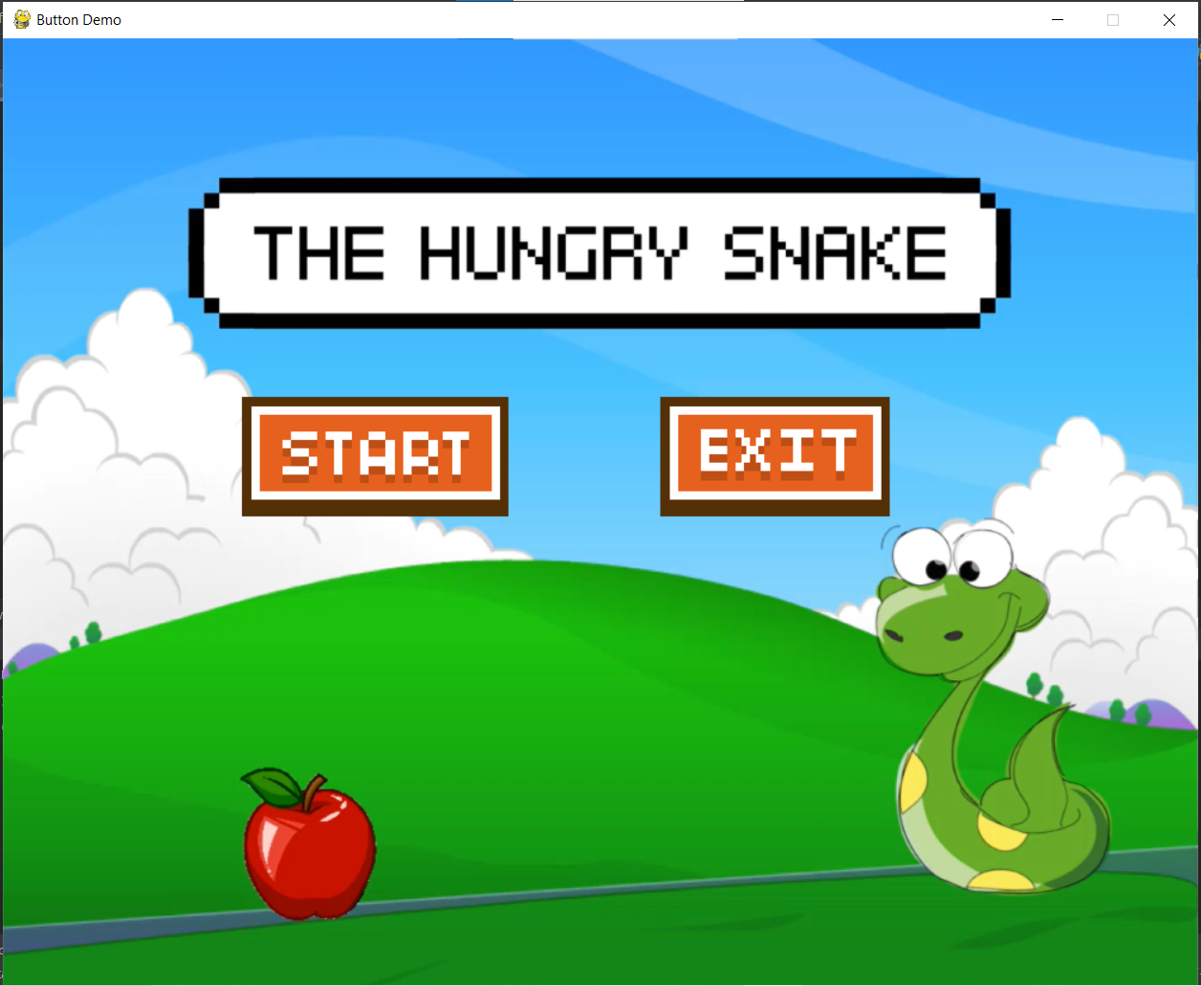
Main Menu
Game screenshots

Slide 9
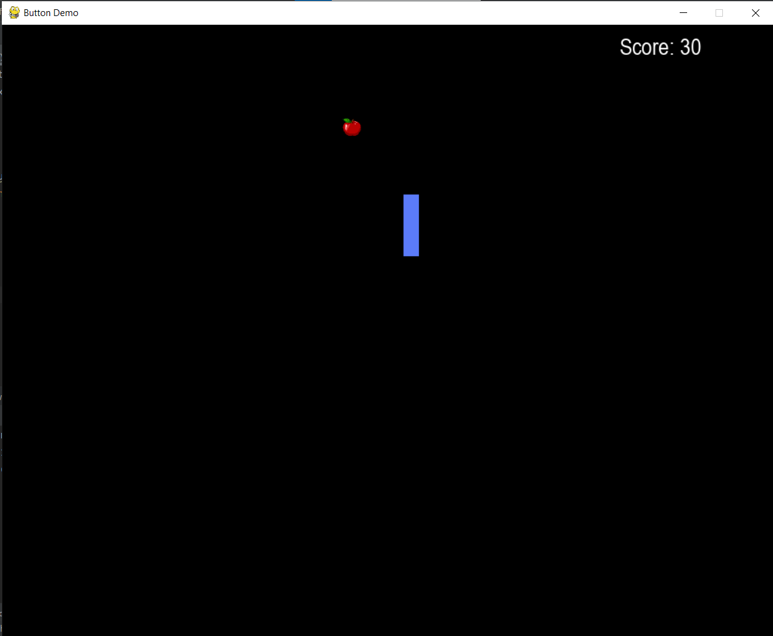
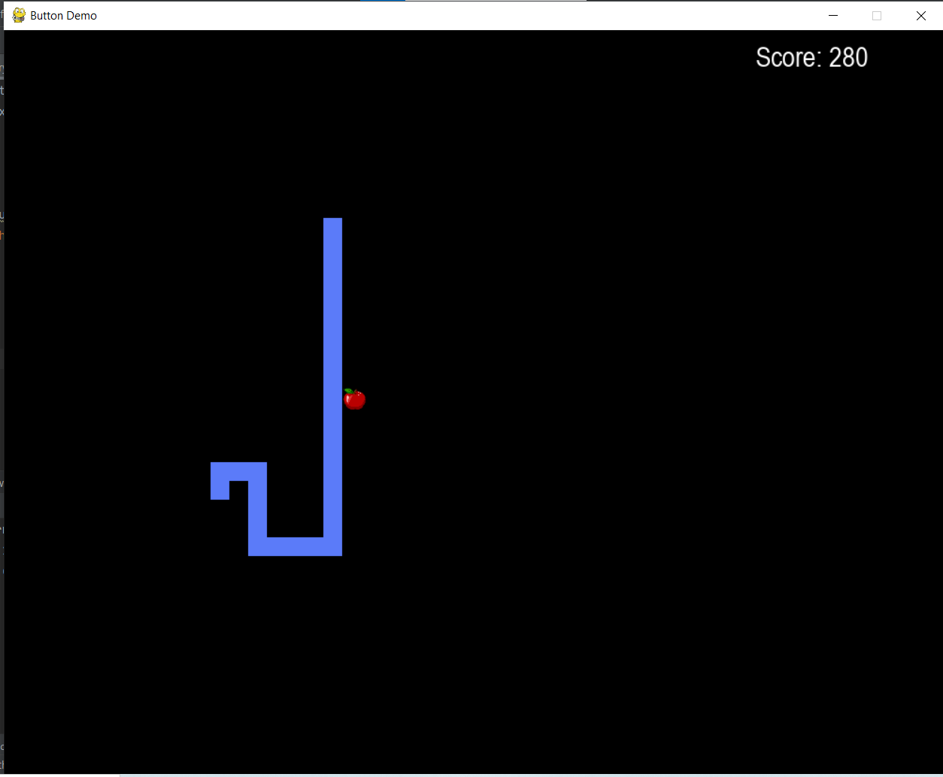
Game Image

Slide 10

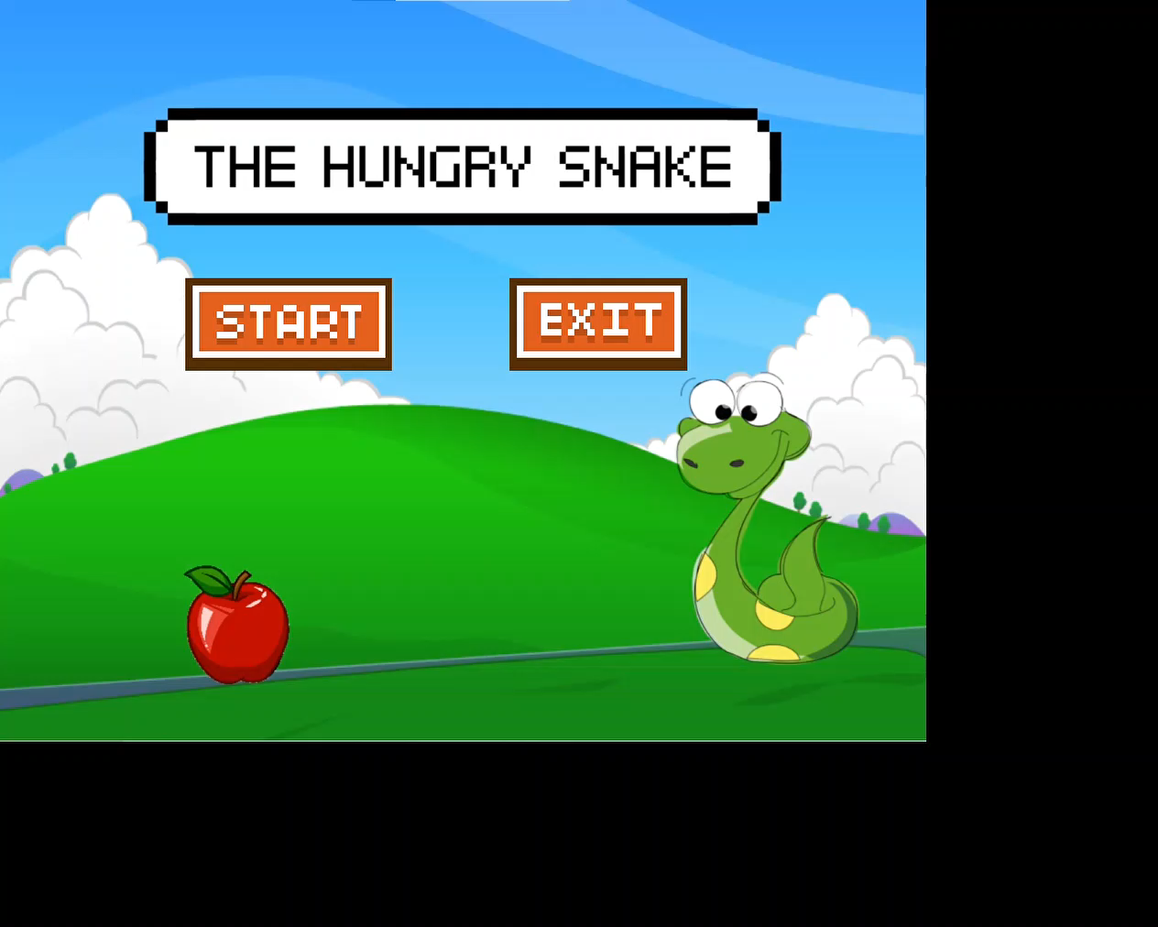

Slide 11
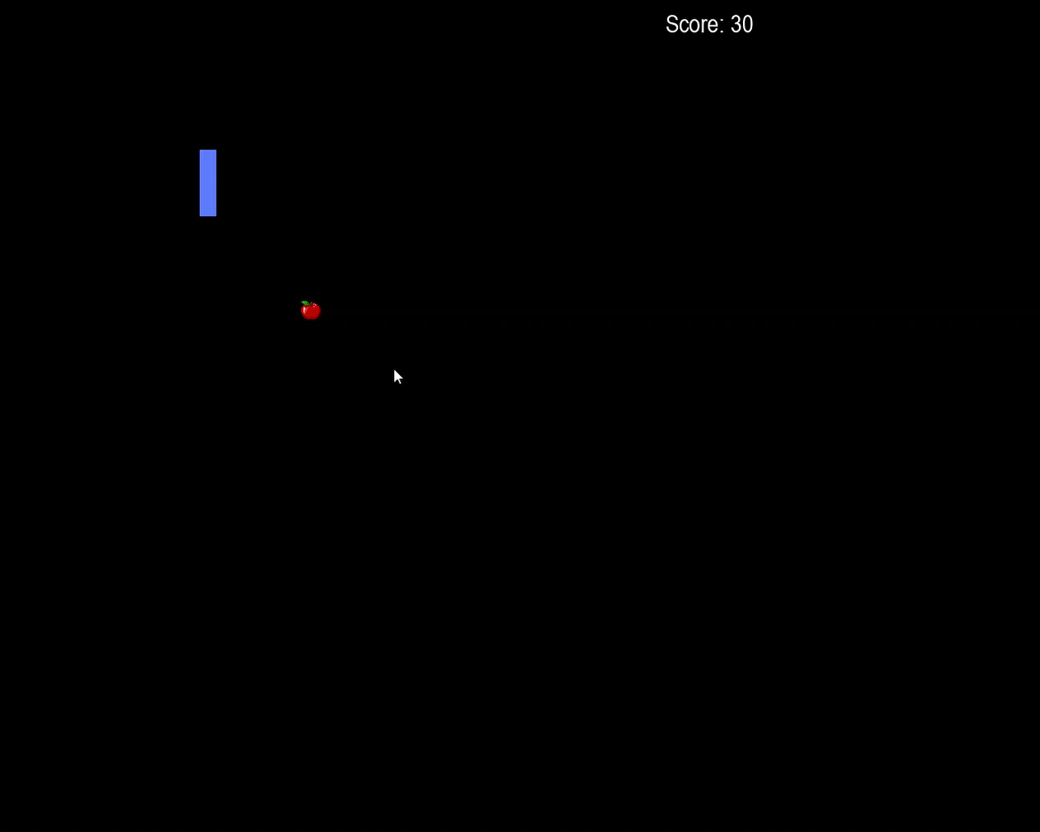
Wall Collision

Slide 12
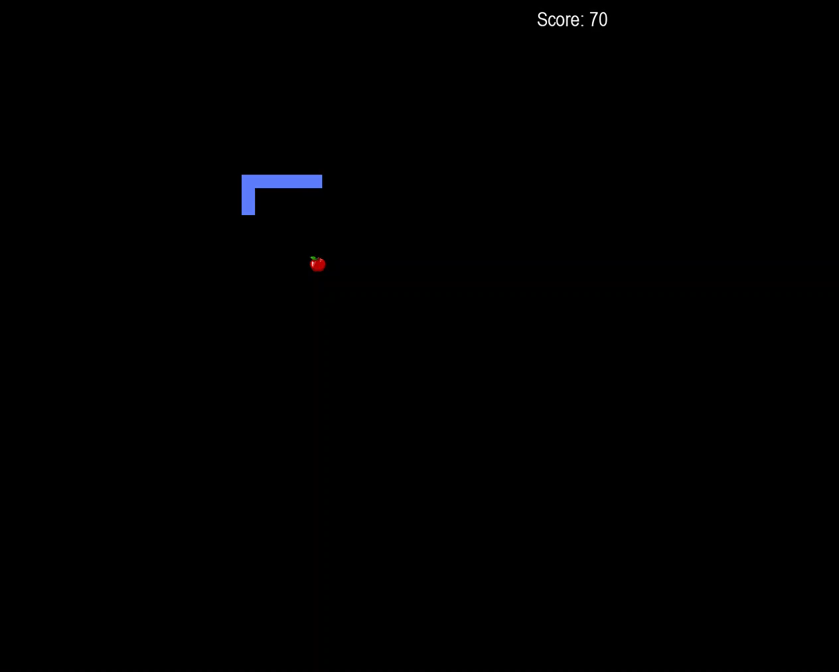
Self Collision

Slide 13
Improvements
Snake eats apples
Snake gets larger
Snake dies from wall and self collision
Added music
Scoreboard
Added menu

Slide 14
Thank You

